Slide 1
Standard Operating Procedure
Labview-Keithley Interface

Slide 2
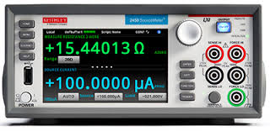

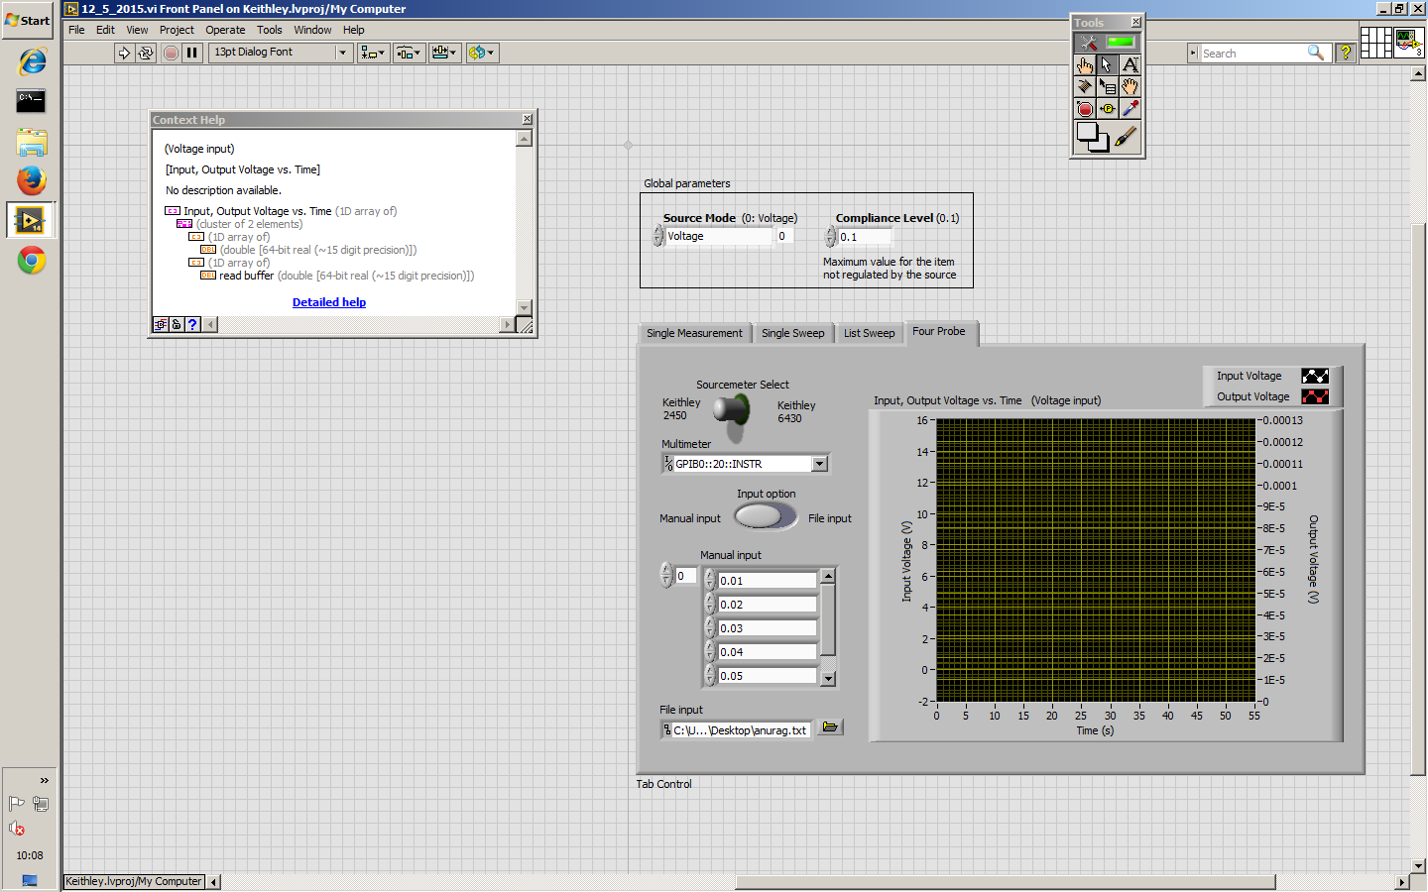
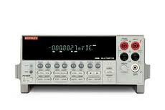
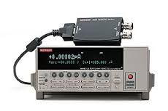
Block Diagram
Keithley 2450
Keithley 2000
Labview 2014
Graphical User Interface
Keithley 6430

Slide 3
Single Measurement

Slide 4
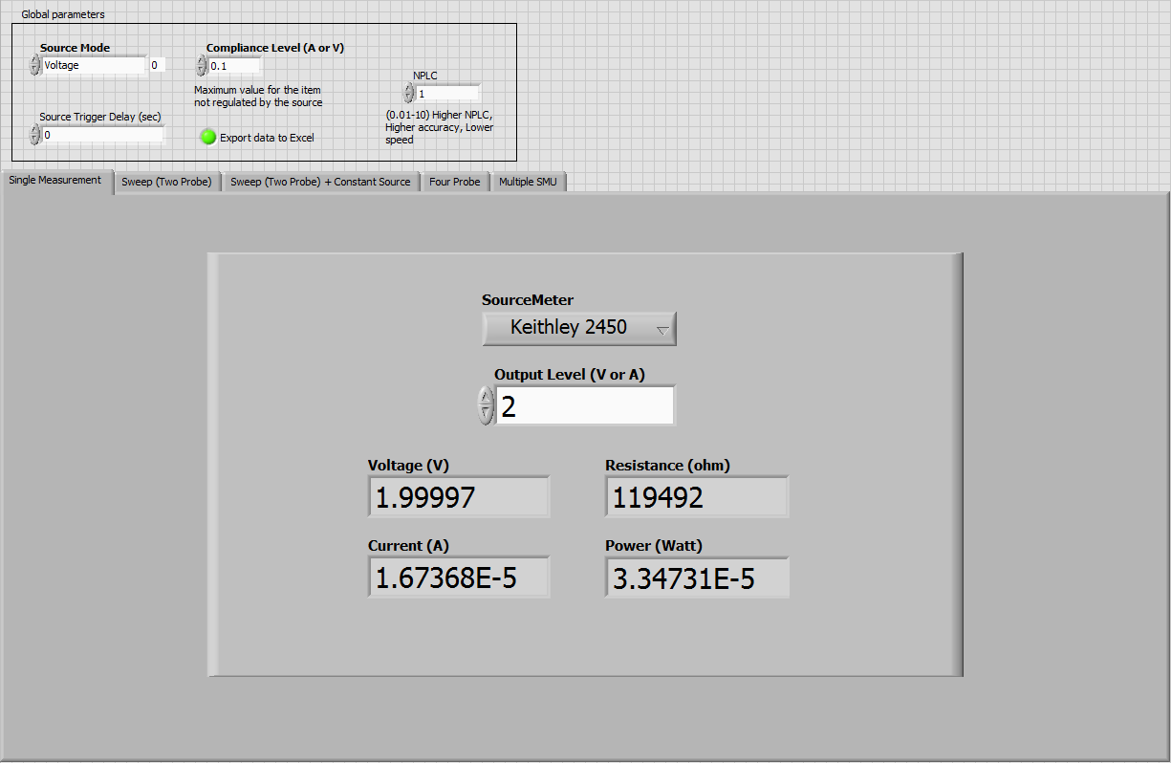
Set the source mode: <Voltage> or <Current>.

Slide 5
Set the compliance level for unregulated item. For voltage source, compliance should be corresponding to current and vice versa. Refer to maximum compliance level in datasheet of instrument.

Slide 6
Set additional time delay between source triggering to decrease sampling speed. Note that source has inbuilt delay, so this value adds on top of that. Refer to plot of Delay vs. NPLC in excel file for approximate inbuilt delay.

Slide 7
Export Data to Excel feature not available in Single Measurement mode

Slide 8
Specify no. of power line cycles the measurement should be integrated for taking readings

Slide 9
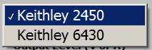
Select the SourceMeter to be used from drop down menu.

Slide 10
Specify the output voltage (V) or current value (A) depending on source mode.

Slide 11
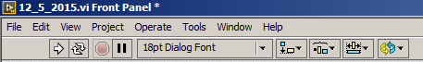
Click on Run Button on the top-left corner of the screen to initiate measurement.

Slide 12
Sweep (Two Probe)

Slide 13
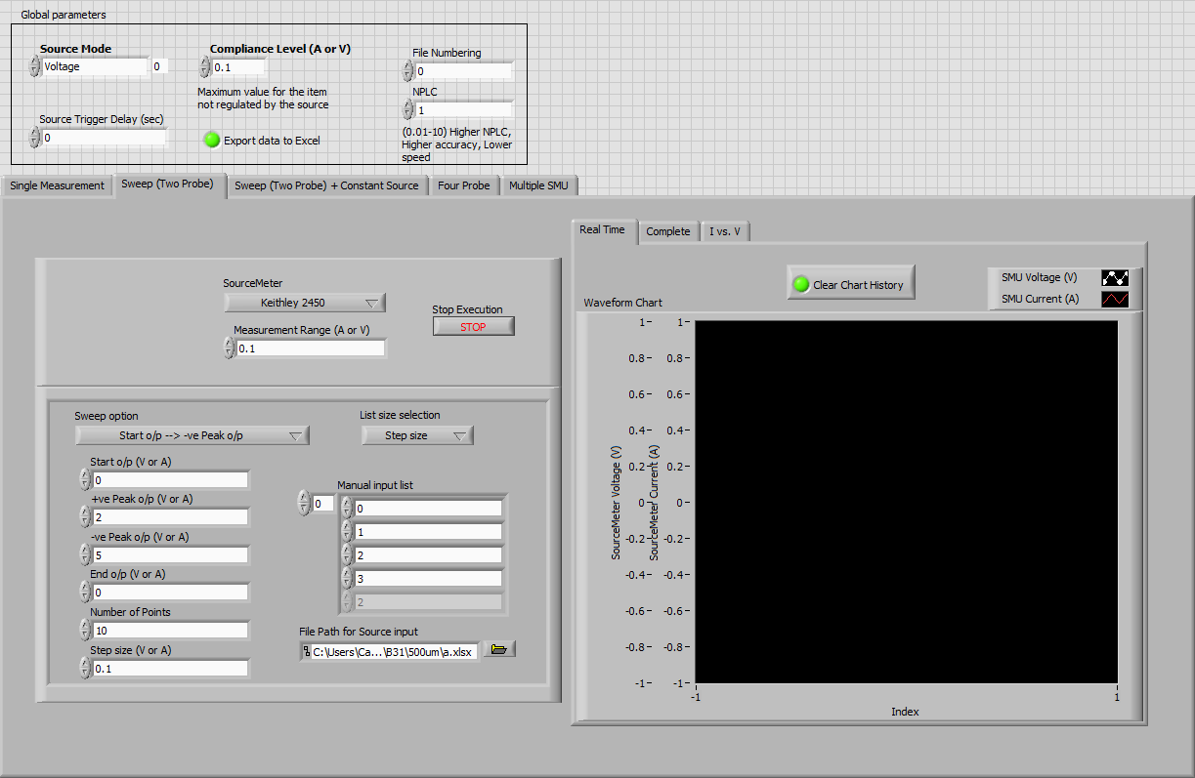
Set the source mode: <Voltage> or <Current>.

Slide 14
Set the compliance level for unregulated item. For voltage source, compliance should be corresponding to current and vice versa. Refer to maximum compliance level in datasheet of instrument.

Slide 15
Set additional time delay between source triggering to decrease sampling speed. Note that source has inbuilt delay, so this value adds on top of that. Refer to plot of Delay vs. NPLC in excel file for approximate inbuilt delay.

Slide 16
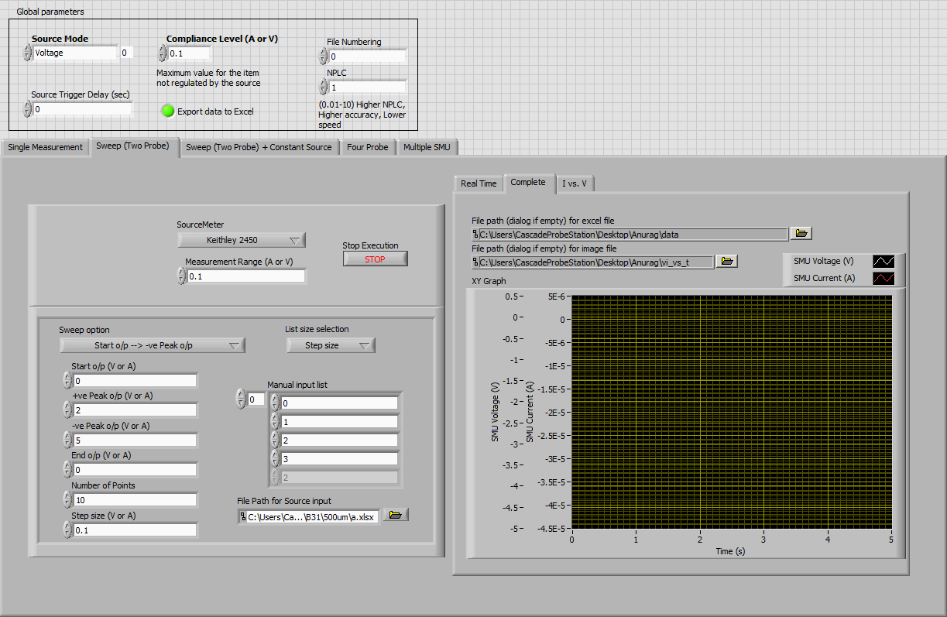
Turning this on (green color) would export the plot data into an excel file whose path is specified in File path.
Similarly specify file name for image file. Remember not to put any file extensions in any file name
Refer to end of SOP as to how to “Specify excel or image file location”

Slide 17
Specify no. of power line cycles the measurement should be integrated for taking readings

Slide 18
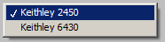
Select the SourceMeter to be used from drop down menu.

Slide 19
Enter the measurement range for SourceMeter. For voltage source mode, range should correspond to current and vice-versa.

Slide 20
Stop execution button breaks the program run in between.

Slide 21
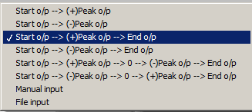
Select the sweep option and list size selection from drop down menu

Slide 22
Specify start output, peak output, end output, manual input list, file path in the numeric control box depending upon the option chosen in the last step. Note that for File input, file should be either .csv or .txt file and not .xlsx file.
Also +ve peak o/p and -ve peak o/p should be +ve value if required for sweep option

Slide 23
Click on Run Button on the top-left corner of the screen to initiate measurement.

Slide 24
Sweep (Two Probe + Constant Source)

Slide 25
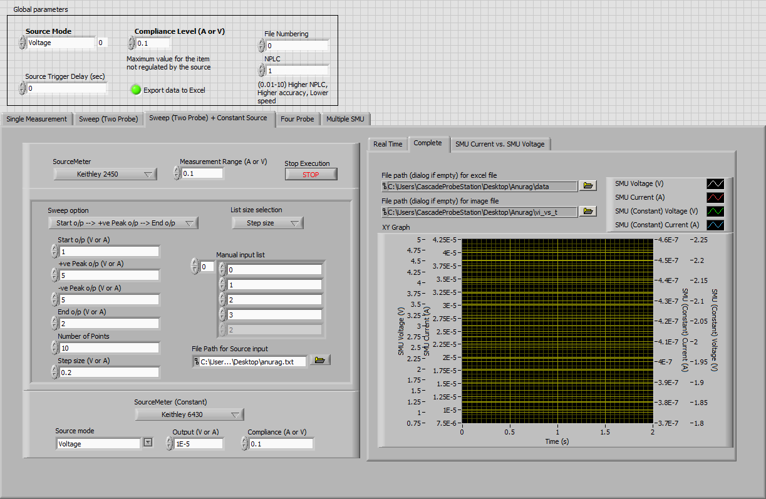
Set the source mode: <Voltage> or <Current>.

Slide 26
Set the compliance level for unregulated item. For voltage source, compliance should be corresponding to current and vice versa. Refer to maximum compliance level in datasheet of instrument.

Slide 27
Set additional time delay between source triggering to decrease sampling speed. Note that source has inbuilt delay, so this value adds on top of that. Refer to plot of Delay vs. NPLC in excel file for approximate inbuilt delay.

Slide 28
Turning this on (green color) would export the plot data into an excel file whose path is specified in File path.
Refer to end of SOP as to how to “Specify excel or image file location”

Slide 29
Specify no. of power line cycles the measurement should be integrated for taking readings

Slide 30
Select the SourceMeter to be used from drop down menu.

Slide 31
Enter the measurement range for SourceMeter. For voltage source mode, range should correspond to current and vice-versa.

Slide 32
Stop execution button breaks the program run in between.

Slide 33
Select the sweep option and list size selection from drop down menu

Slide 34
Specify start output, peak output, end output, manual input list, file path in the numeric control box depending upon the option chosen in the last step. Note that for File input, file should be either .csv or .txt file and not .xlsx file.
Also +ve peak o/p and -ve peak o/p should be +ve value if required for sweep option

Slide 35
Similarly, specify the configuration for SourceMeter with constant voltage or constant current output.

Slide 36
Four Probe

Slide 37
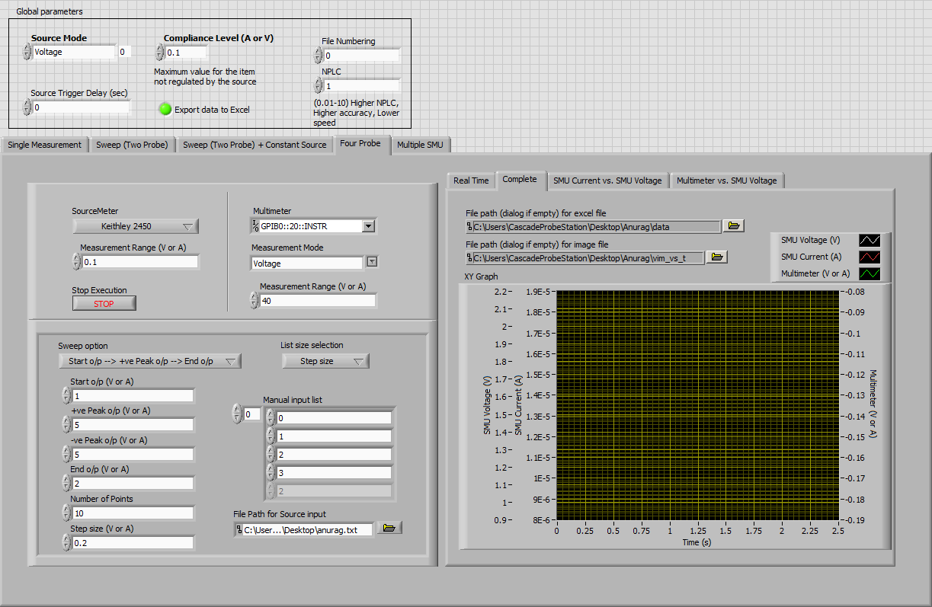
Set the source mode: <Voltage> or <Current>.

Slide 38
Set the compliance level for unregulated item. For voltage source, compliance should be corresponding to current and vice versa. Refer to maximum compliance level in datasheet of instrument.

Slide 39
Set additional time delay between source triggering to decrease sampling speed. Note that source has inbuilt delay, so this value adds on top of that. Refer to plot of Delay vs. NPLC in excel file for approximate inbuilt delay.

Slide 40
Turning this on (green color) would export the plot data into an excel file whose path is specified in File path.
Refer to end of SOP as to how to “Specify excel or image file location”

Slide 41
Select the SourceMeter to be used from drop down menu.

Slide 42
Enter the measurement range for SourceMeter. For voltage source mode, range should correspond to current and vice-versa.

Slide 43
Stop execution button breaks the program run in between.

Slide 44
Similarly, specify multimeter to be used, its measurement mode and measurement range. Note that currently only Keithley 2450 is supported to be used as multimeter.

Slide 45
Select the sweep option and list size selection from drop down menu

Slide 46
Specify start output, peak output, end output, manual input list, file path in the numeric control box depending upon the option chosen in the last step. Note that for File input, file should be either .csv or .txt file and not .xlsx file.
Also +ve peak o/p and -ve peak o/p should be +ve value if required for sweep option

Slide 47
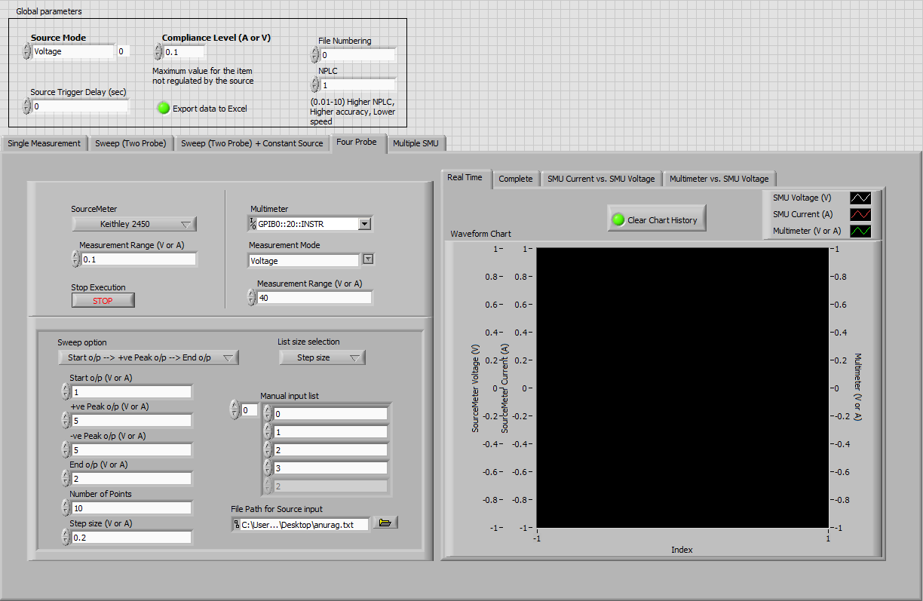
You can also choose to see measurement in real time by selecting real time option from Plots tab. Depending upon your need, you can choose to delete previous reading or start plot from last index.

Slide 48
Click on Run Button on the top-left corner of the screen to initiate measurement.

Slide 49
Multiple SMU

Slide 50
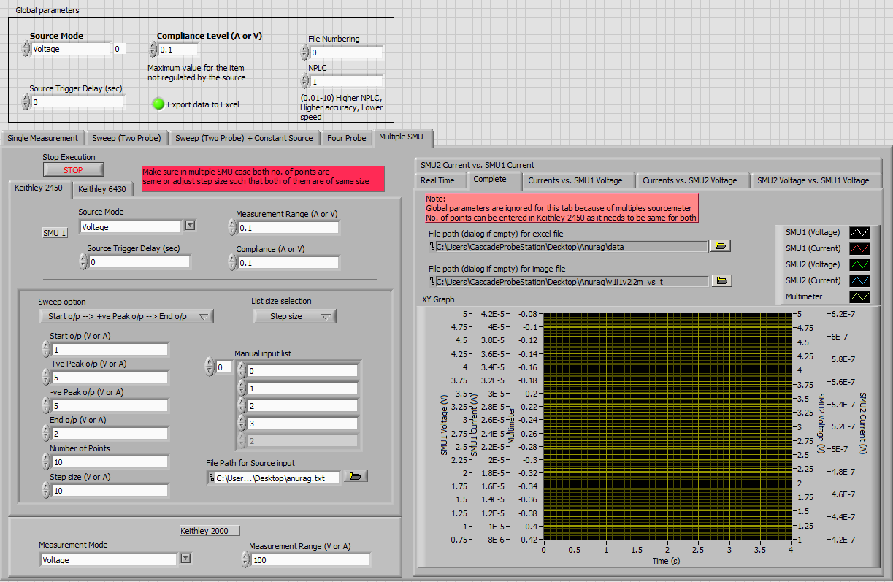
To provide individual control over two SMU, global parameters are ignored and local parameters are used

Slide 51
Stop execution button breaks the program run in between.

Slide 52
Select the source mode, measurement range, source trigger delay and compliance level for Keithley 2450

Slide 53
Specify start output, peak output, end output, manual input list, file path in the numeric control box depending upon the option chosen in the last step. Note that for File input, file should be either .csv or .txt file and not .xlsx file
Specify start output, peak output, end output, manual input list, file path in the numeric control box depending upon the option chosen in the last step. Note that for File input, file should be either .csv or .txt file and not .xlsx file.
Also +ve peak o/p and -ve peak o/p should be +ve value if required for sweep option

Slide 54
Repeat the selection of source mode, measurement range, source trigger delay and compliance level for Keithley 6430 by navigating SourceMeter configuration tab.

Slide 55
Select the sweep option from the drop down menu and fill the input box as per the sweep mode. Note that there is no option for no. of points in sweep option as it’s taken same for both the sourcemeter.

Slide 56
Select the measurement mode and measurement range for Keithley 2000 multimeter.

Slide 57
Click on Run Button on the top-left corner of the screen to initiate measurement.

Slide 58
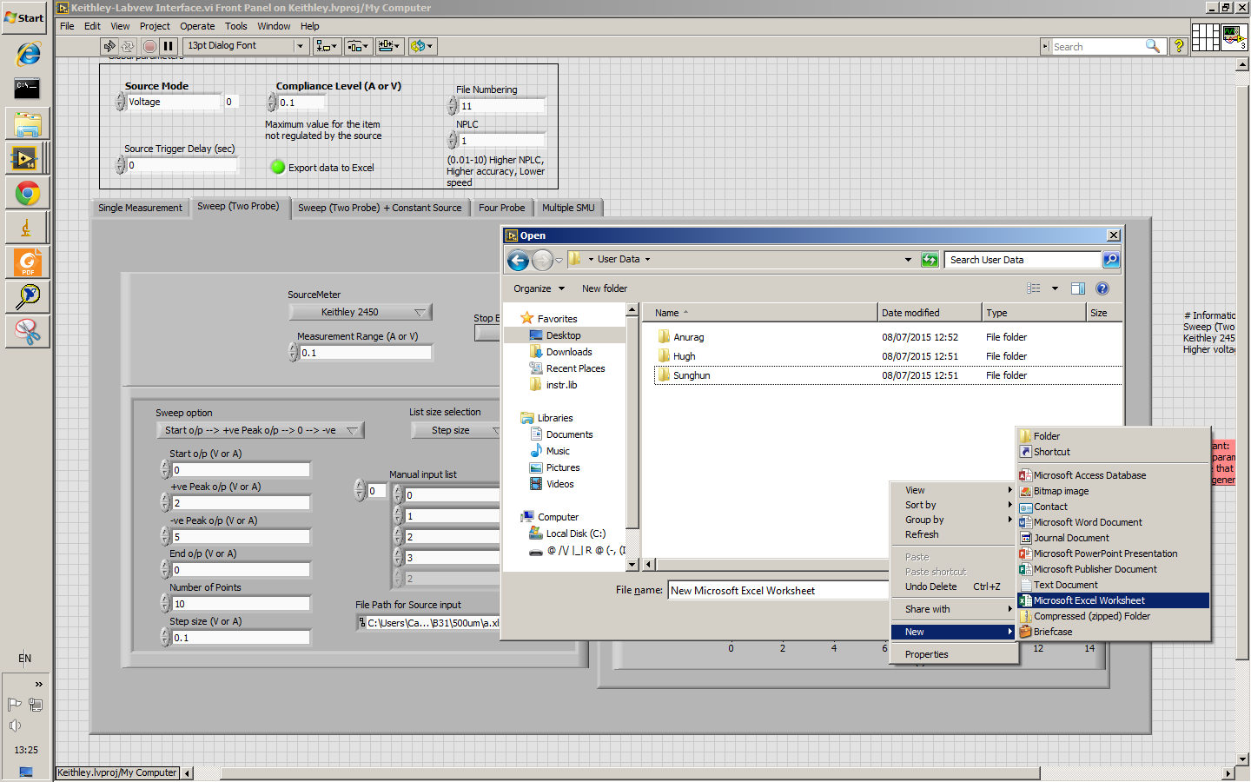
Specifying excel or image file location
Go to Plot tab and click on browse button.
In case your source folder does not contain a file, you need to create a new excel file (or any file) as illustrated on right.

Slide 59
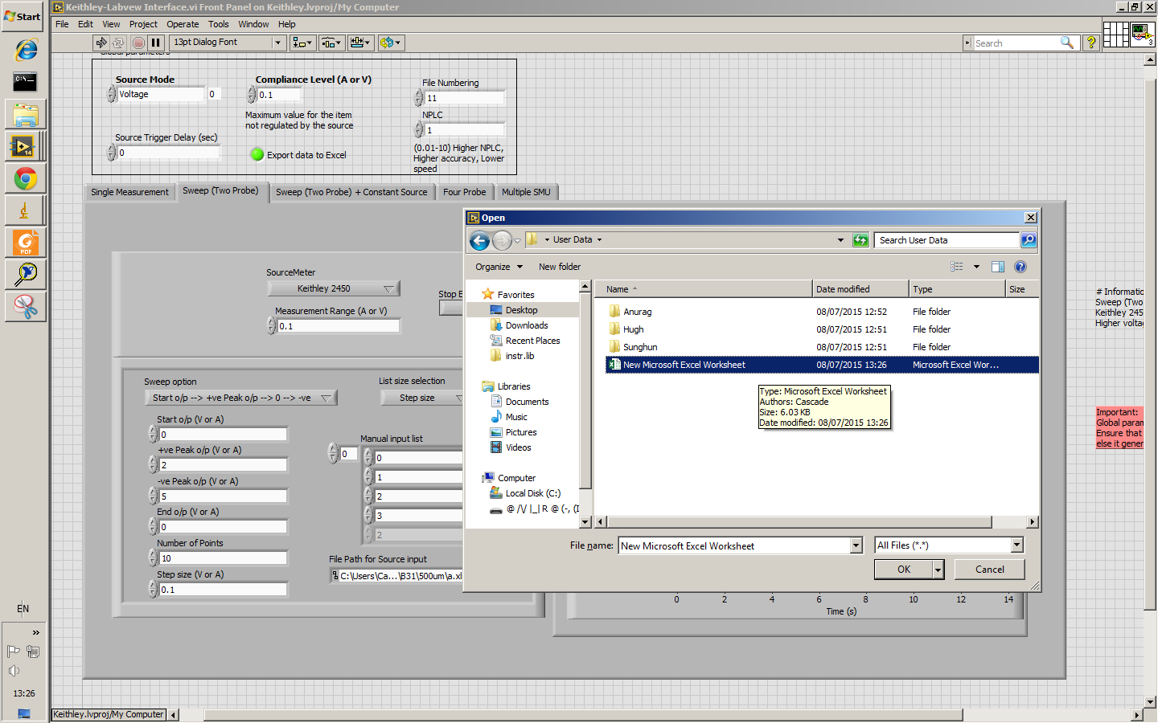
Specifying excel or image file location
Select that file and click on Ok

Slide 60
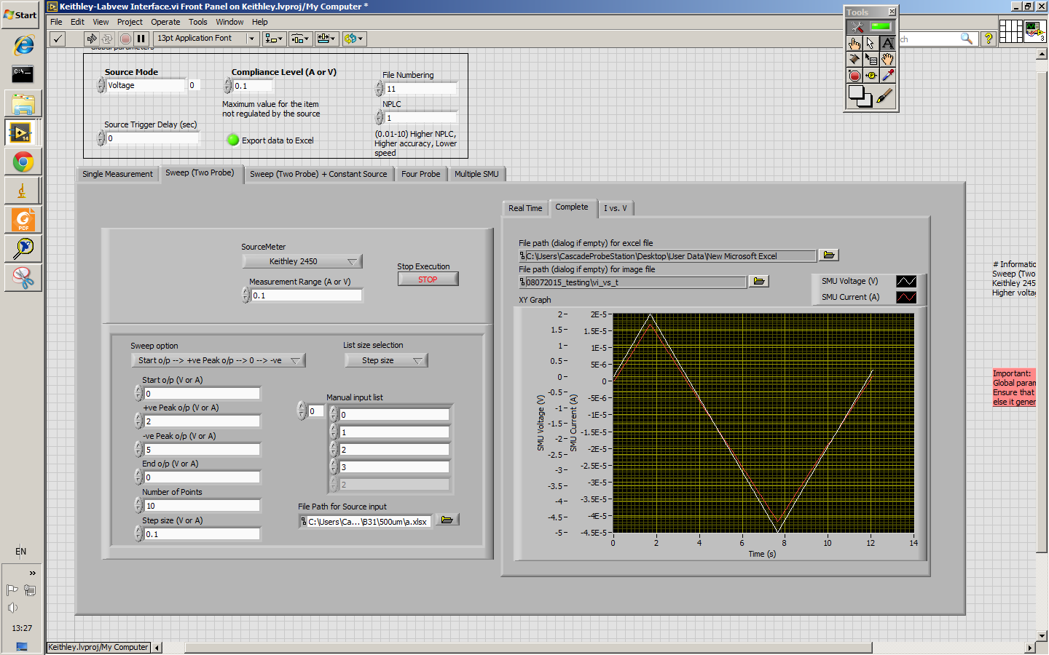
Specifying excel or image file location
Now you can give any name to your output file by manually editing the highlighted area (for specifying excel file). Similarly one should specify file name for image file too.
In the Global parameter window on top, you can define starting file Number for all excel and image file in File Numbering numeric box.

Slide 61
SOP Lab 3.27
http://tinyurl.com/sop-lab-3-27

